Slide 1


Node.js
Reporter
Andenaik Barseghyan
https://github.com/Andranik93/Presentation

Slide 2





1.1
Content
Whot is Node.js
Libuv. Event Loop. Threads
V8 Engin. WebAssembly
Core Modules. C++ Bindings
C-ares. ZLib. HTTP Parser. OpenSSL
Microtask and Macrotask

Slide 3

Whot is Node.js
®
Node.js is a JavaScript runtime built on Chrome's V8 JavaScript engine.
Node.js uses an event-driven(Reactor Pattern), non-blocking I/O model that mastes is lightweight and efficient.

Slide 4
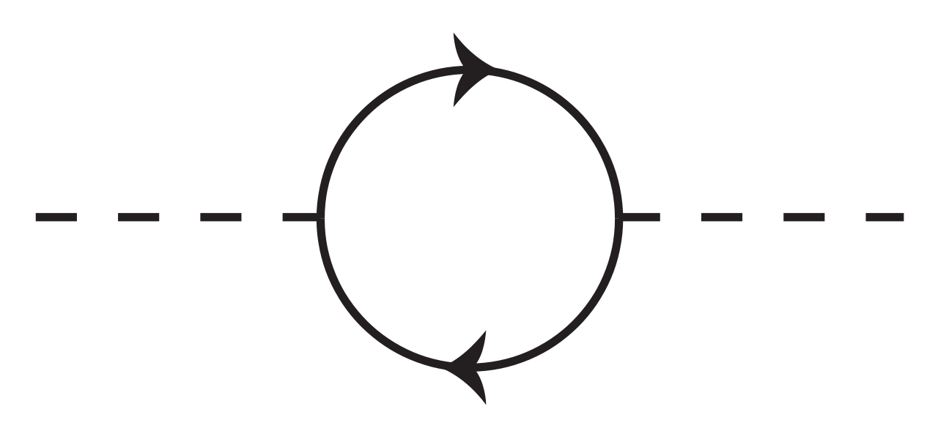
4.2
Reactor Pattern
I/O reques
Synchronous Event Demultiplexer
Event Queue
Event Loop
Hardware I/O
The reactor design pattern is an event handling pattern for handling service requests delivered concurrently to a service handler by one or more inputs. The service handler then demultiplexes the incoming requests and dispatches them synchronously to the associated request handlers
Structure: Synchronous Event Demultiplexer, Dispatcher, Request Handler

Slide 5










Node.js Architecture
Addons
Core Modules

Slide 6

Libuv
Written in
Event Loop
C
Operating system
Libuv (Unicorn Velociraptor Library) is a multi-platform C library that provides support for asynchronous I/O based on event loops.
Type
I/O abstraction library
Cross-platform
Features
Full-featured event loop backed by epoll, kqueue, IOCP, event ports.
Asynchronous
TCP and UDP sockets.
DNS resolution.
Asynchronous
file and file system
operations.
File system
events.
ANSI escape code controlled TTY.
Child processes.
IPC with
socket sharing, using Unix domain sockets or named
pipes.
Thread pool.
Signal handling.
High resolution clock.

Slide 7


Event Loop
Add your title
Add your title
Add your title
Add your title
Add your title
Add your title

Slide 8




2.2
Add title
Add your title
Add your title
Add your words here,according to your need to draw the text box size
Add your title
Add your words here,according to your need to draw the text box size
Add your words here,according to your need to draw the text box size

Slide 9









2.3
Add title
Add your words here,according to your need to draw the text box size
Add your words here,according to your need to draw the text box size
Add your words here,according to your need to draw the text box size
Add your words here,according to your need to draw the text box size
Add your words here,according to your need to draw the text box size

Slide 10






Module in Node.js is a simple or complex functionality organized in single or multiple JavaScript files which can be reused throughout the Node.js application.
Each module in Node.js has its own context, so it cannot interfere with other modules or pollute global scope. Also, each module can be placed in a separate .js file under a separate folder.
Node.js implements CommonJS modules standard. CommonJS is a group of volunteers who define JavaScript standards for web server, desktop, and console application.
Core Modules
Http
Path
http module includes classes, methods and events to create Node.js http server
path module includes methods to deal with file paths.
Url
fs
url module includes methods for URL resolution and parsing.
path module includes methods to deal with file paths.
Querystring
util
Querystring module includes methods to deal with query string.
util module includes utility functions useful for programmers.

Slide 11
C++ Bindings
Add your title
Add your title
Add your words here,according to your need to draw the text box size
Add your words here,according to your need to draw the text box size
Add your title
Add your title
Add your words here,according to your need to draw the text box size
Add your words here,according to your need to draw the text box size
Add your title
Add your title
Add your words here,according to your need to draw the text box size
Add your words here,according to your need to draw the text box size

Slide 12
Javascript V8 engin
Keywords
Keywords
Keywords
Add your words here,according to your need to draw the text box size.Please

Slide 13
C-ares. ZLib. HTTP Parser. OpenSSL
3.1
1
C-ares
is a C library for asynchronous DNS requests (including name resolves).
C89 compatibility, MIT licensed, builds for and runs on POSIX, Windows, Netware, Android and many more operating systems
2
ZLib
zlib is a software library used for data compression. zlib was written by Jean-loup Gailly and Mark Adler and is an abstraction of the DEFLATE compression algorithm used in their gzip file compression program. zlib is also a crucial component of many software platforms, including Linux, macOS, and iOS.
3
HTTP Parser
This is a parser for HTTP messages written in C. It parses both requests and responses. The parser is designed to be used in performance HTTP applications. It does not make any syscalls nor allocations, it does not buffer data, it can be interrupted at anytime. Depending on your architecture, it only requires about 40 bytes of data per message stream (in a web server that is per connection).
https://github.com/Samsung/http-parser
4
OpenSSL
OpenSSL is a software library for applications that secure communications over computer networks against eavesdropping or need to identify the party at the other end. It is widely used by Internet servers, including the majority of HTTPS websites.
OpenSSL contains an open-source implementation of the SSL and TLS protocols. The core library, written in the C programming language, implements basic cryptographic functions and provides various utility functions. Wrappers allowing the use of the OpenSSL library in a variety of computer languages are available.
The OpenSSL Software Foundation (OSF) represents the OpenSSL project in most legal capacities including contributor license agreements, managing donations, and so on. OpenSSL Software Services (OSS) also represents the OpenSSL project, for Support Contracts.
OpenSSL is available for most Unix-like operating systems (including Linux, macOS, and BSD) and Microsoft Windows.

Slide 14
3.1
Add title
YOUR TITLE
YOUR TITLE
YOUR TITLE
YOUR TITLE
YOUR TITLE
Add title
Add title
Add title
Add title
Add title
Add your words here
Add your words here
Add your words here
Add your words here
Add your words here

Slide 15


4.1
Add title
Add your title
Add your title
Add your title
Add your title
Add your title
Add your title
Add your title
Add your title
Add your words here,according to your need to draw the text box size.Please read the instructions and more work at the end of the manual template.

Slide 16


4.2
Add title
Add your title
Add your words here,according to your need to draw the text box size.Please read the instructions and more work at the end of the manual template.

Slide 17

4.3
Add title
Add your words here,according to your need to draw the text box size.Please read the instructions and more work at the end of the manual template.

Slide 18
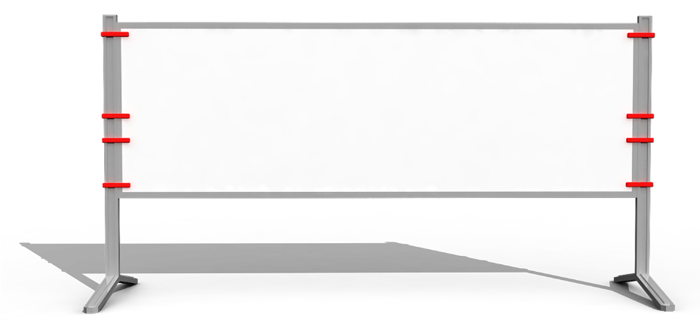

5.1
Add title
Add your words here,according to your need to draw the text box size.Please read the instructions and more work at the end of the manual template.

Slide 19

5.3
Add title
1
Add your words here
2
Add your words here
3
Add your words here
4
Add your words here
5
Add your words here

Slide 20
5.3
Add title
Add your words here,according to your need to draw the text box size.Please read the instructions and more work at the end of the manual template.
Add your words here
Add your words here,according to your need to draw the text box size.Please read the instructions and more work at the end of the manual template.
Add your words here
Add your words here,according to your need to draw the text box size.Please read the instructions and more work at the end of the manual template.
Add your words here

Slide 21
6.2
Add title
Add your words here,according to your need to draw the text box size
S
W
Add your words here,according to your need to draw the text box size
O
T
Add your words here,according to your need to draw the text box size
Add your words here,according to your need to draw the text box size

Slide 22

6.3
Add title
1 Add your title
Add your words here,according to your need to draw the text box size
3 Add your title
Add your words here,according to your need to draw the text box size
2 Add your title
Add your words here,according to your need to draw the text box size
4 Add your title
Add your words here,according to your need to draw the text box size

Slide 23
6.3
Add title
Add your words here
Add your words here
Add your words here
TEXT
TEXT
TEXT
TEXT
TEXT
TEXT
Add your words here
Add your words here
Add your words here

Slide 24
Thank you！

